Slide 1

Term Deposit Subscription Prediction
By -
MOHIT ADHIKARI (MGFM-1901)
ADITYA BAKDE (MFT-1902)
DIVYAM BHATT (MFT-1903)
ROHIT RAMASWAMY (MFT-1912)

Slide 2

Introduction – Technology used
Python:
Widely used general purpose high-level programming language
Developed for emphasis on code reliability
Shorter codes for concept expression
Efficient system integration
IDE or Integrated Development Environment used: PyCharm
Tableau
Powerful and fastest growing data visualization tool
Features
Data blending
Real time analysis
Collaboration of data
Does not require technical/programming skills to operate
Widely used in business intelligence industry

Slide 3
Objectives
To predict whether the client will subscribe to a term deposit or not
To train and test a data set consisting of users’ data
To implement multiple algorithms and compare them to see which approach is more suitable to the case
Algorithms used:
Decision tree
Random Forest
Naive Bayes
K-Means

Slide 4
Dataset
The data is related with direct marketing campaigns based on phone calls of a Portuguese banking institution.
The classification goal is to predict if the client will subscribe (yes/no) a term deposit (variable y).
41188 Entries and 17 Variables

Slide 5
Attributes
Basic Client Data : age, job, marital, education, default, balance, housing, loan
Related with the last contact of the current campaign : contact, month, day_of_week, duration
Other attributes : campaign, pdays, previous, poutcome
Output variable (desired target) : y - has the client subscribed a term deposit?

Slide 6
Pre-processing
Checked for Null or Missing Values to avoid ambiguity
Convert String values into Numeric values
Treating the Numeric Values as factors
Split the data into training and test sets – 70 : 30

Slide 7
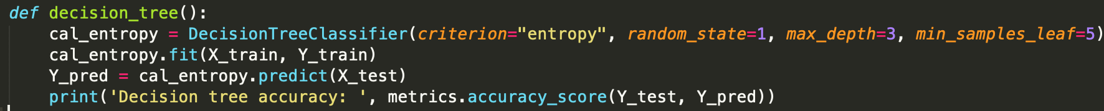
Decision Tree
cal_entropy = DecisionTreeClassifier(criterion="entropy", random_state=1, max_depth=3, min_samples_leaf=5)
Accuracy : 0.8897736488977365 or 88.9%

Slide 8
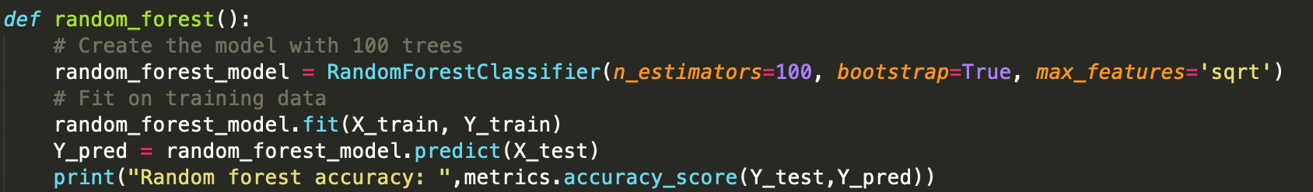
Random Forest
random_forest_model = RandomForestClassifier(n_estimators=100, bootstrap=True, max_features='sqrt’)
Accuracy : 0.9023077490230775 or 90.2%

Slide 9
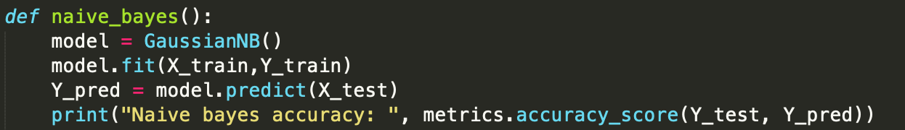

Naive Bayes
Formula for calculating the conditional probability:
$$P\left(H | E\right)=\frac{P\left(E|H\right)∗P\left(H\right)}{P\left(E\right)}$$
Accuracy : 0.8607977586079776 or 86.07%

Slide 10
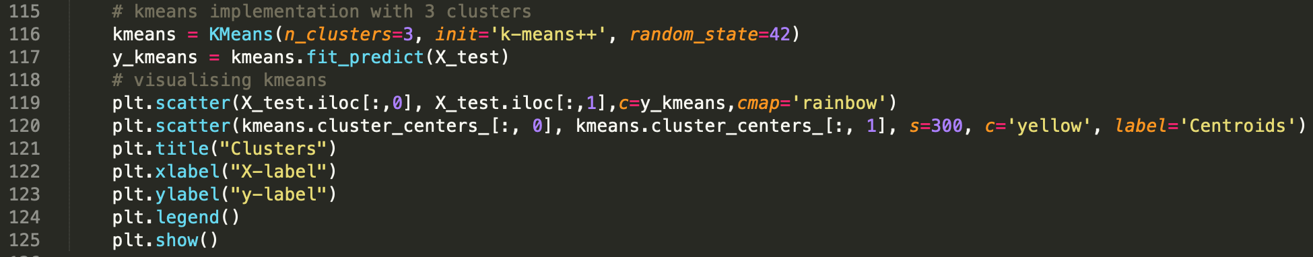
K-Means
Calculated Optimum number of clusters using elbow method
Classified Data points in clusters
Visualise the Clusters

Slide 11
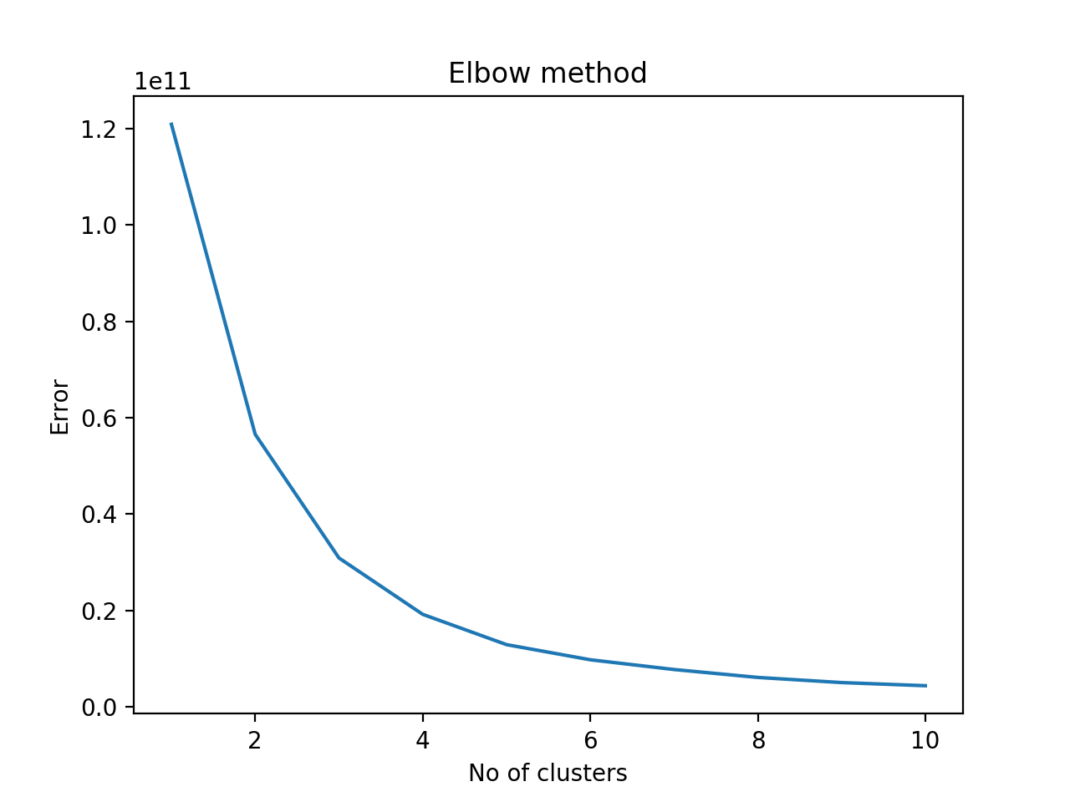
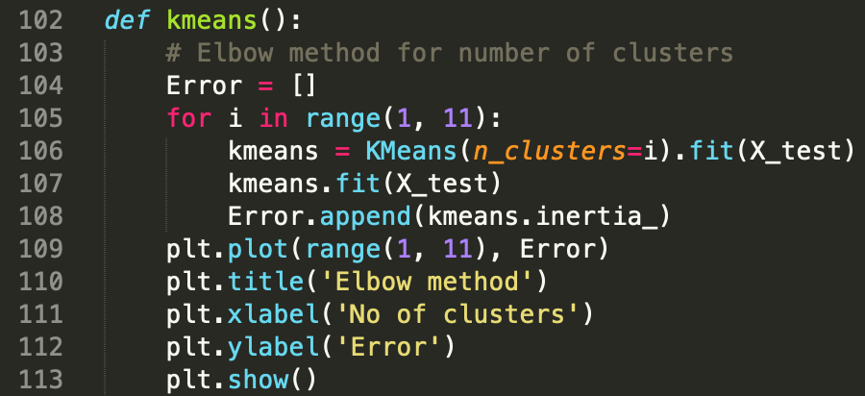
Elbow Method

Slide 12
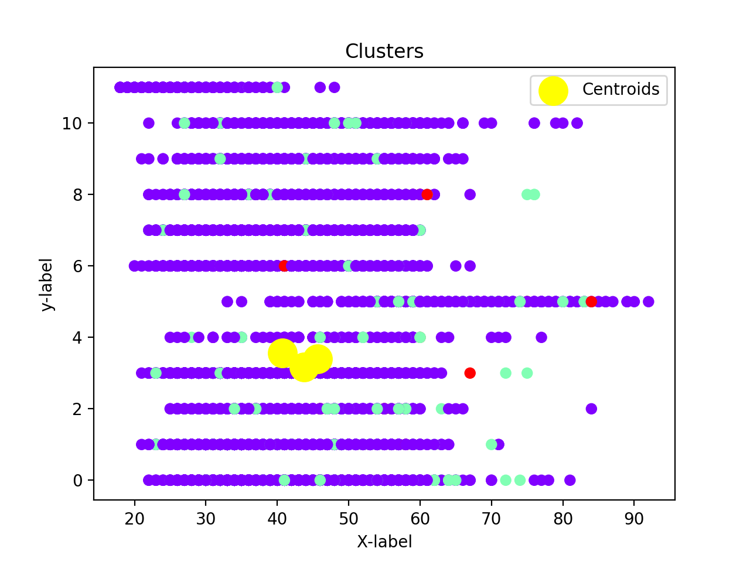

Slide 13
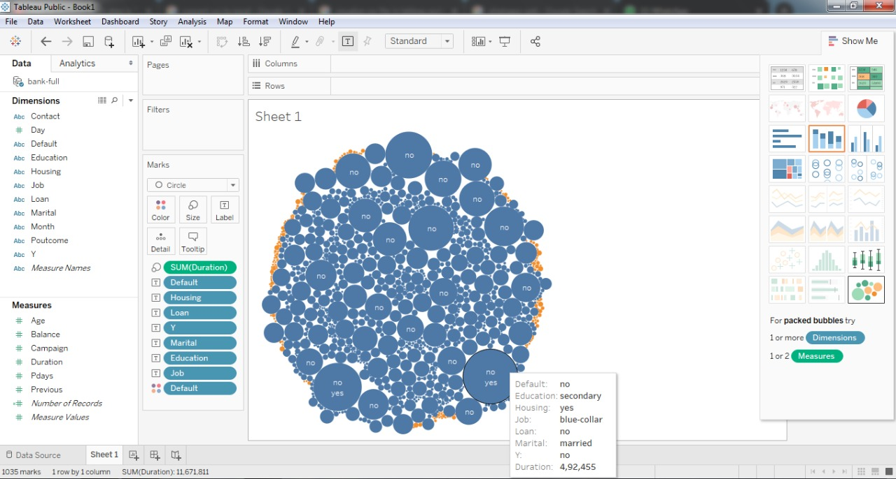
Tableau

Slide 14
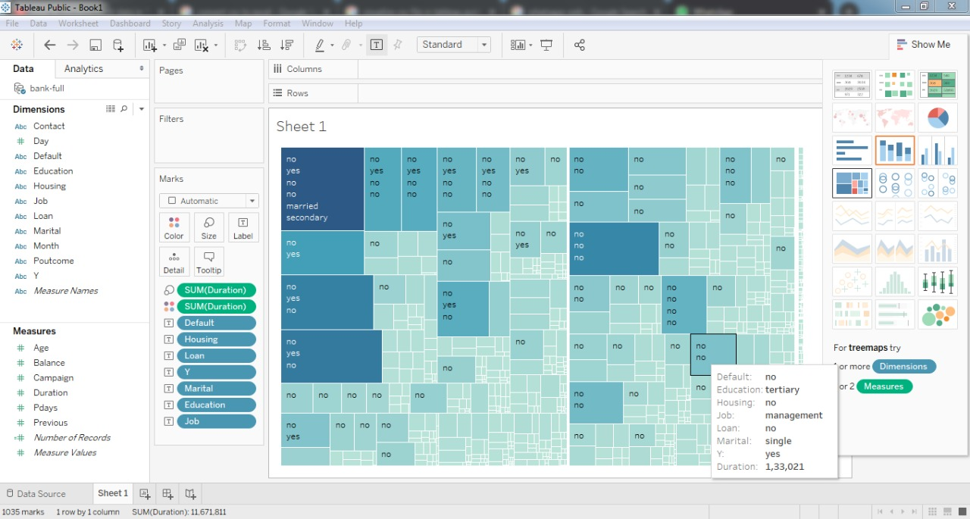

Slide 15
Conclusion
Objective was achieved.
Model successfully predicts whether a person would subscribe to a term deposit or not.
Prediction algorithms proved to be better than clustering algorithms(K-Means) for this particular purpose
They gave an accuracy between 86%-90%
The nature of the algorithms allows it to be applied to various datasets to predict further outcomes.
Team of people from mixed backgrounds allowed for greater learnings.

Slide 16
Thank You

